Slide 1
Visual Fire Detection and People Density Monitoring System
Team Members:
ADARSH MENON - 20BCR7010
N K V MANASA - 20BCR7035
FAZAL K MOHAMMAD – 20BCR7008
JUAN JOHNSON – 20BEC7007
GAUTHAM H S – 20BCE7190
ALEN SEBASTIAN V – 20BCR7018

Slide 2
AGENDA
Problem Statement
Survey
Abstract
Literature Review
Proposed Features to be incorporated in the final Prototype
Block Diagram
Flowchart
Components and Budget Estimation
Architecture
Key Milestones
Conclusion
References

Slide 3
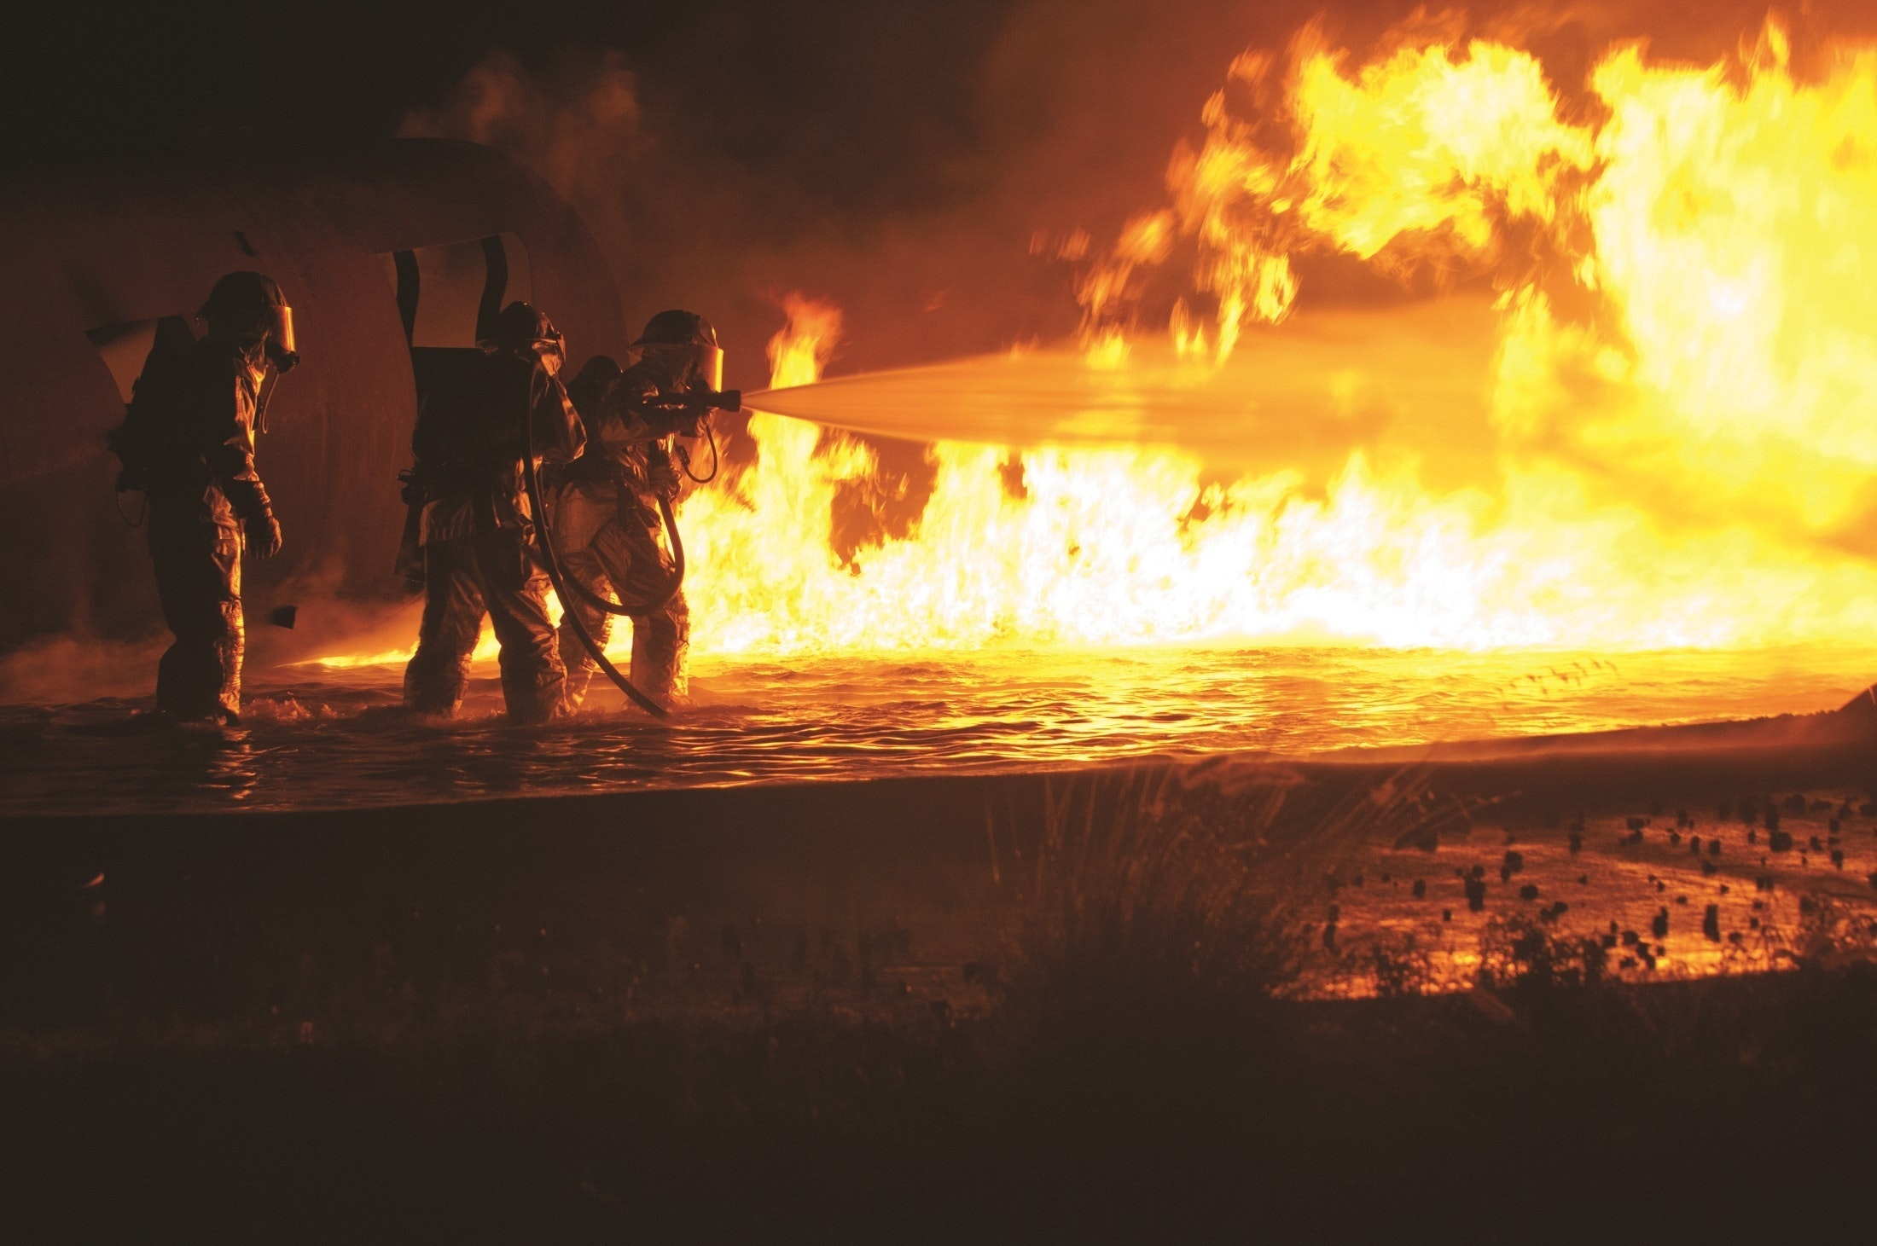


PROBLEM STATEMENT
Fire incidents have a huge damaging impact on human life as well as property in residential and industrial areas. On the other hand, the risk of fires is growing in conjunction with the growth of urban buildings due to increase in population and lack of ventilation. Traditional fire detection equipment’s have a chance of failure and also have a high possibility of giving false alarm moreover they cannot give dynamic attributes like number of people trapped in fire and the intensity of fire. One of the major problems among fire fighters is to find the number of trapped people in the building among all the smoke generated in fire

Slide 4
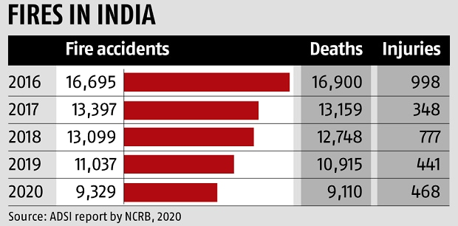
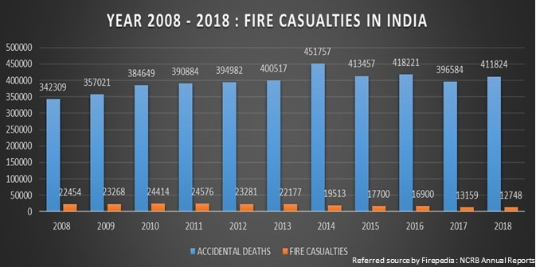
SURVEY
As per the National Crime Records Bureau, about over 60 people die every day in India due to fire. Every year, about 25,000 persons die due to fires and related causes, in India. Women account for about 66% of those killed in fire accidents. Fire accounts for about 6% of the total deaths reported due to natural and unnatural causes.
Bulk of the cases reported every year are under the other causes category. Between 2001 and 2018, a total of 3.16 lakh fire accident cases were reported in the country. More than 20000 cases were reported in 12 of the 14 years. The highest number of cases were reported in 2011 (26343). The number of cases reported witnessed a mixed trend in the last 14 years. The number of cases saw a decline from 2001 to 2004 only to increase continuously from 2004. This increasing trend continued till 2011 only to be followed by a decreasing trend till 2014.

Slide 5
ABSTRACT
In this project, we propose an architecture using raspberry pi and a camera to provide an accurate number of people trapped in the building and moreover, find the location of trapped people and detect fire using, deep neural network (DNN) models, i.e., MobileNet SSD and ResNet101 which are embedded in the vision node which is the camera and raspberry pi. We also use FOMO algorithm to find out the estimated number of people trapped inside the whole building. A web application is developed and integrated with the vision node through a local server for visualizing the real-time events in the building related to the fire and getting the count of people. In this proposed system concentration on sensors are omitted with the usage of HSV algorithm, which identifies the fire with the help of the Hue, Saturation and the value of the color obtained from the live video .In the proposed system, a webcam is used instead of a surveillance camera for convenience .

Slide 6
LITERATURE REVIEW
S.No | Title of Papers and Authors | Year | Existing Work
1 | Fire detection using smoke and gas sensors Chen, S. J., Hovde, D. C., Peterson, K. A., & Marshall, A. W[IEEE] | 2007 | Fire detection can be delayed due to smoke generation and detection time, leading to damage before prevention measures can be taken.
2 | Novel method of real time fire detection and video alerting system using open-cv techniques M. Karthikeyen, N. Ramya, M. Sai Priya and C. Yuvalakshmi[MDPI] | 2021 | Fire detection and giving alerts using mailing system which is a very traditional way and it is not sustainable
3 | Fire Detection Using Deep Learning And Opencv Vinaya Gawali, Saloni Pawar, Muskan Chhangani,Arsh Shrivastava,K.A. Kalokhe [] | 2022 | The system uses advanced Deep learning and Convolutional Neural Networks technology to detect the fire and OpenCV technology to capture the images

Slide 7
Proposed Features to be incorporated in the Final Prototype
Accurate detection of fire
This system uses HSV algorithm, which identifies the fire with the help of the Hue, Saturation and the value of the colour obtained from the live video .In the proposed system, a camera is used .The process involved in proposed system.
Counting of people
To get the estimated number of people in the building we will use the FOMO algorithm with the MobileNet SSD algorithm which allows us to calculate the number of people exiting the area through the exit. The number of people trapped can be found out by subtracting the people who enter the building by the people who are exiting the building
Web Application
It then streams the real-time output and the live feed to a network, which is then parsed by an application listening to the stream port. This feed can then be used by the concerned authorities to plan out further steps and evacuation procedures.

Slide 8
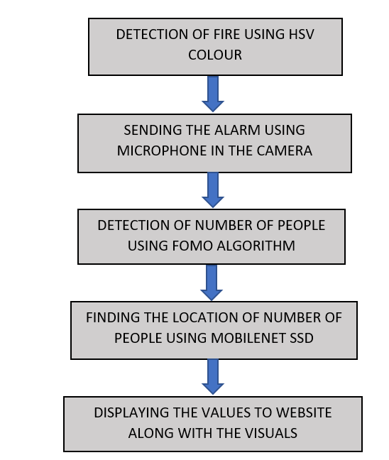
BLOCK DIAGRAM

Slide 9
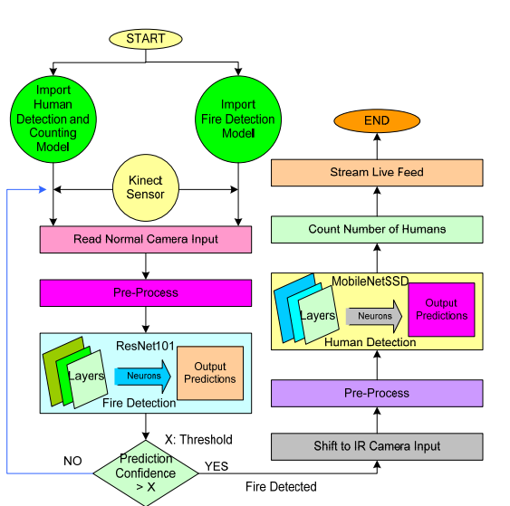
FLOWCHART OF PROPOSED ARCHITECTURE

Slide 10
COMPONENTS AND BUDGET ESTIMATION
Raspberry Pi 4 Model B
A series of single board computers
CPU: Broadcom BCM2711, quad-core Cortex-A72 (ARM v8) 64-bit SoC @ 1.5GHz
RAM: 2GB, 4GB, or 8GB LPDDR4-3200 SDRAM (depending on model)
Networking: Gigabit Ethernet, 2.4GHz and 5GHz 802.11b/g/n/ac wireless, Bluetooth 5.0, BLE, Gigabit Ethernet, 2 USB 3.0 ports, 2 USB 2.0 ports, 2 micro-HDMI ports (up to 4kp60 supported), 3.5mm audio jack, and 40-pin GPIO header.
Storage: microSD card slot for loading operating system and data storage
Operating System: Supports multiple operating systems including Raspberry Pi OS, Ubuntu, and Windows 10 IoT Core.
2) Kinect Sensor
The Kinect sensor is a motion-sensing device developed by Microsoft for the Xbox 360 and later for Windows-based computers. Here are the specifications for the original Xbox 360 version of the Kinect sensor:
Video camera: 640x480 pixel resolution, 30 frames per second
Depth sensor: 320x240 pixel resolution, 30 frames per second
Connectivity: USB 2.0
S. NO. | Name Of Component | No of Pieces | Price Estimation
1. | Raspberry Pi 4 Model B | 1 | Rs. 8000/-
2. | Kinect Sensor | 1 | Rs. 4000/-
 |  |  | Total = 12,000/-

Slide 11
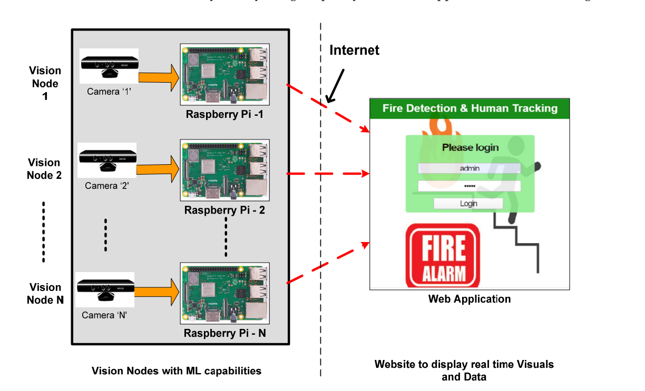
ARCHITECTURE OF THE SYSTEM

Slide 12

KEY MILESTONES
Milestone 1
Milestone 2
Milestone 3
Milestone 4
Project Proposal
1st Review
2nd Review
3rd Review
07 – 02 - 2023
11 – 02 - 2023
12 – 03 - 2023
09 – 04 - 2023
0
02
03
Identifying Problem Statement, Formulating the system and Budget Estimation
Final Prototype
Suggestions and Final Touches
01
02
03
Oth
1st
2nd
3rd
20YY
2023

Slide 13
CONCLUSION
Fire detection and people estimation are very crucial during a fire accident. Early fire detection enables suggesting a safe exit path from the building for the people inside the building. Moreover, it is important to find the number of people stuck inside the building during a fire accident. Thus, in order to detect fires and to estimate the number of people in real time, we require a real-time visual capturing system. In this project, we have implemented a vision node based on Raspberry Pi with machine learning capabilities for detecting fire and estimating people count accurately in real time. Along with the vision node, we have designed a web interface that is capable of triggering all connected vision nodes by authorized signing in to the portal. Here, the vision node interfaces with the web portal through a local server hosted on Raspberry Pi. As the vision node is switched on, it starts capturing the real-time frame. Moreover, a machine learning-based pre-trained model processes real-time frames and sends the estimated result on web portals such as the status of fire detection and count of people

Slide 14
REFERENCES
https://www.financialexpress.com/money/fire-safety-are-commercial-and-residential-spaces-in-india-safe-enough/2637244/
https://ieeexplore.ieee.org/abstract/document/341064
http://www.ijeea.in/wp-content/uploads/2021/04/Volume-9-Issue-1-Paper-6.pdf
https://www.mdpi.com/1302514

